Slide 1
Drawbacks of Combinational circuits
If you need to design a system that stores and uses previous input and output, then we can not use a combinational circuit because it doesn’t have capability to store any state or depend clock or and time.
For these properties you can use Sequential circuits.

Slide 2
Sequential logic is a type of logic circuit whose output depends not only on the present value of its input signals but on the sequence of past inputs, the input history as well.
Types of Sequential Circuits
Asynchronous sequential circuits
some or all the outputs of a sequential circuit do not change affect with respect to active transition of clock signal
Synchronous sequential circuits
all the outputs of a sequential circuit change affect with respect to active transition of clock signal.

Slide 3
Memory Element
A memory stores data – usually one bit per element
A snapshot of the memory is called the state
A one bit memory is often called a bistable, i.e., it has 2 stable internal states
Flip-flops and latches are particular implementations of bistables

Slide 4
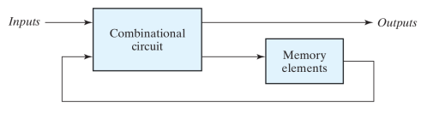
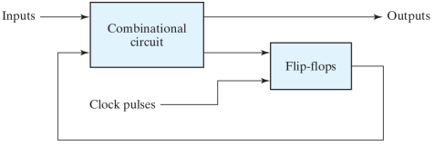

Asynchronous
Element delay determines speed
Basic elements are Latches.
Synchronous
Clock frequency (1GHz, 2GHz,etc.) -> speed
Basic elements are Flip Flops

Slide 5
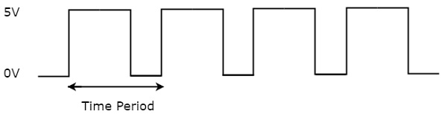
Clock Signal and Triggering
Clock signal
Clock signal is a periodic signal and its ON time and OFF time need not be the same. We can represent the clock signal as a square wave, when both its ON time and OFF time are same.
The time period will be equal to sum of ON time and OFF time.
The reciprocal of the time period of clock signal is known as the frequency of the clock signal.

Slide 6
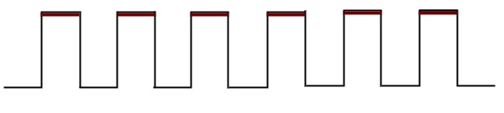
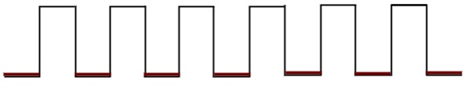
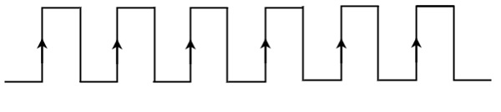
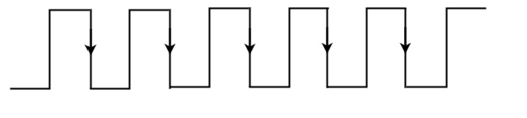
Types of Triggering
Level triggering
Positive level triggering
Negative level triggering
Edge triggering
Positive edge triggering
Negative edge triggering

Slide 7
Latches operate with enable signal, which is level sensitive. Whereas, flip-flops are edge sensitive.

Slide 8
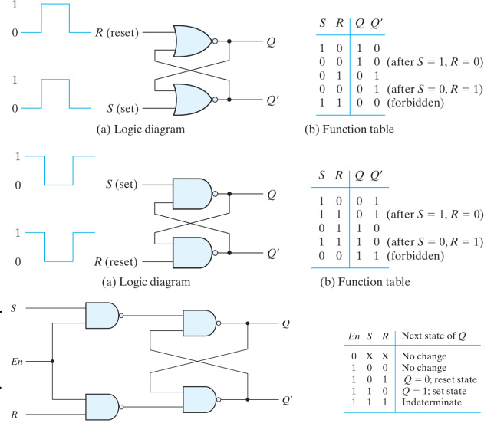
SR latch
Q(t+1)(Q(t), S, R)
SR Latch with NAND implementation

Slide 9
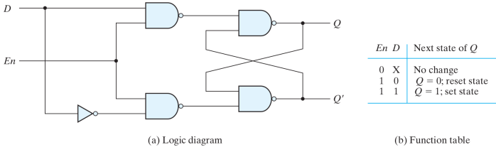
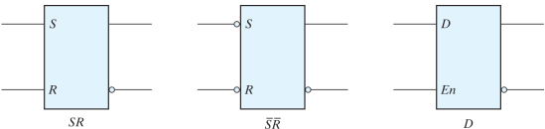
D Latch

Slide 10
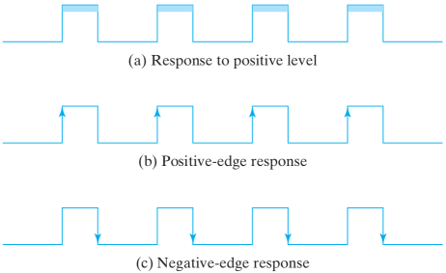
Flip Flops

Slide 11
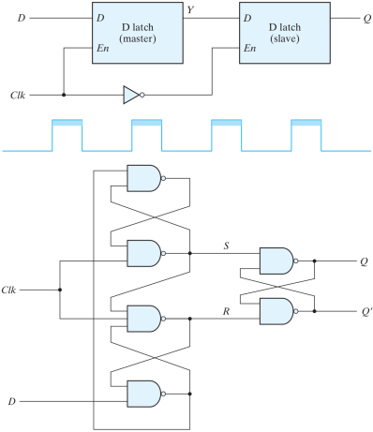
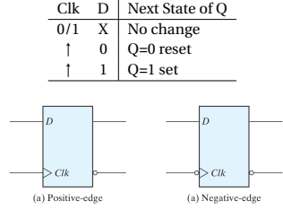
Edge-Triggered D Flip-Flop
From Latches:
Master-Slave Flip-Flop
-ve edge triggered.
f = 1/T

Slide 12
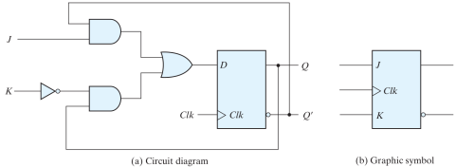
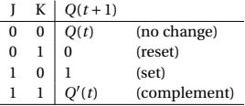
JK Flip-Flops (from D FF)
Input Eq: D = JQ’ + K’Q
Characteristic Equation
Q(t+1) = D
= JQ’+K’Q(t)
Characteristic Table

Slide 13
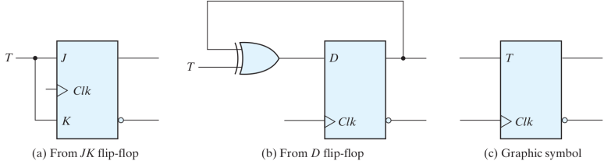

T Flip-Flop (from D or JK FFs)
Input Equation : D = T ⊕ Q
Characteristic equation
Q(t+1) = D
= T ⊕ Q(t)

Slide 14
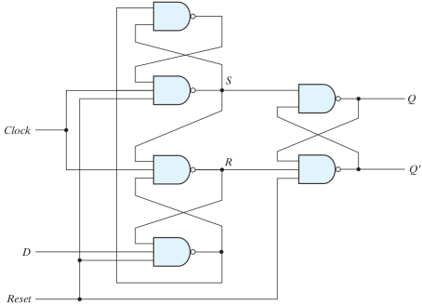
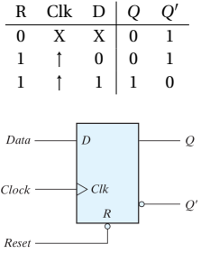
D-FF with asynchronous reset

Slide 15
Analysis and Design
To design of Sequential circuits, the procedure involves the following steps:
Derive the state table and state equations.
Derive the state diagram using the state table.
Reduce states using state reduction technique.
Verify the number of Flip-Flops and type of Flip-Flop to be used.
Derive the excitation equations using the excitation table.
Derive the output function and the Flip-Flop input functions.
Derive the logic functions or equation for each output variable.
Draw the required logic diagram.

Slide 16
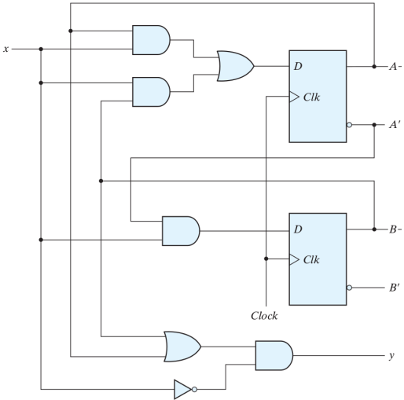
Analysis of Clocked Sequential Circuits (Synchronous Circuits)
Represents in:
. Circuit drawing
. Equation (algebraic expression, state equation, transition equation).
. Table (state table, transition table))
same as truth table,
characteristic table,
functional table
. State diagram (Finite State
Machine(FSM), transition
diagram)
. Timing diagram.

Slide 17
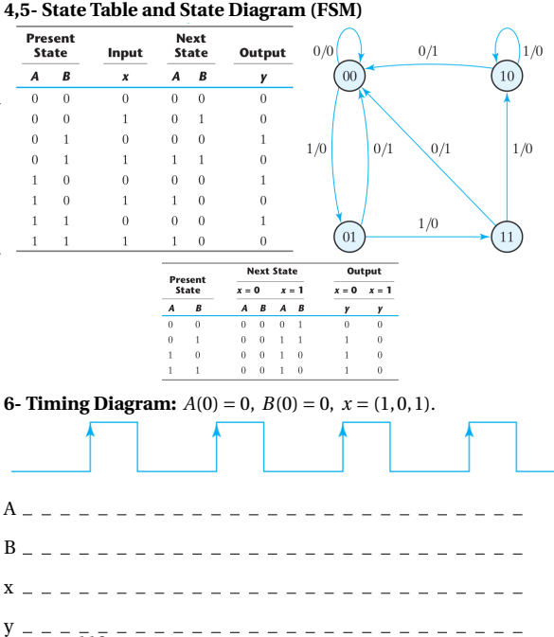
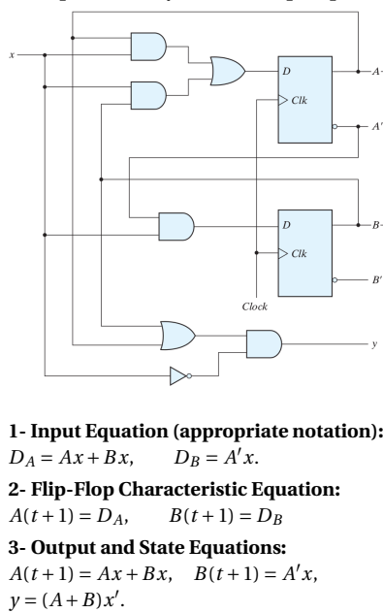
Analysis with D FF

Slide 18
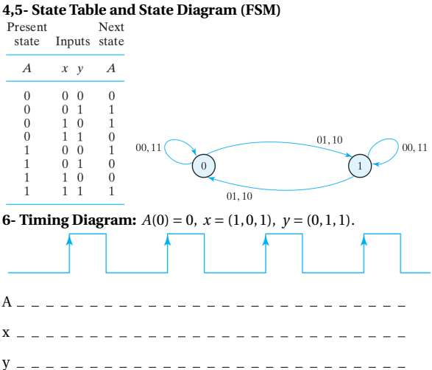
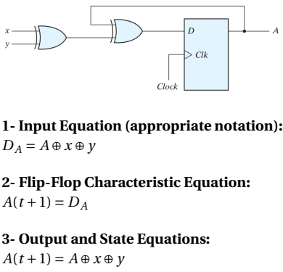
Example

Slide 19
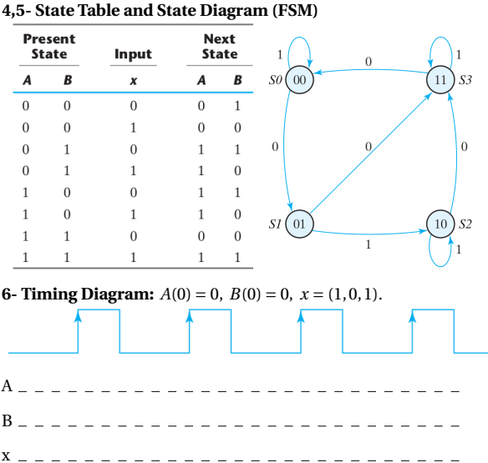
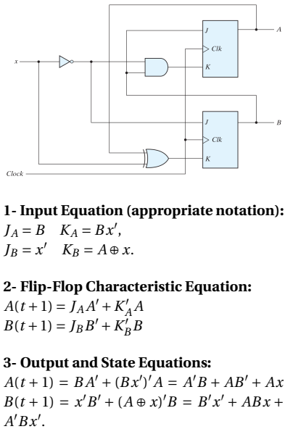
Analysis with JK FF

Slide 20
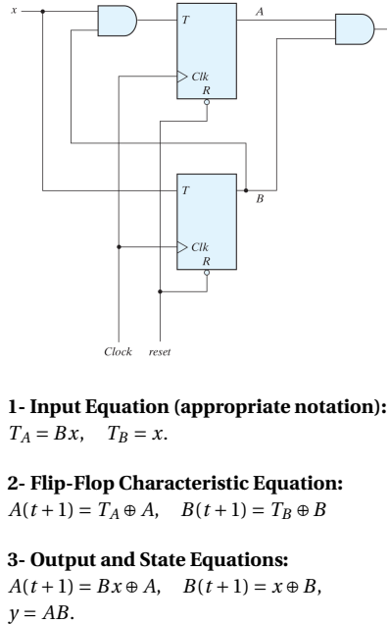
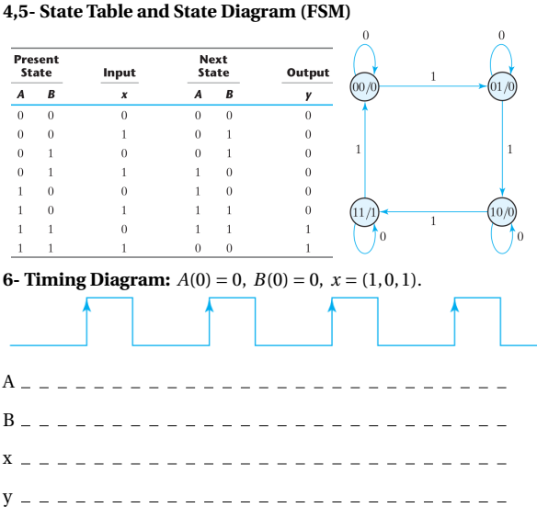
Analysis with T FF

Slide 21
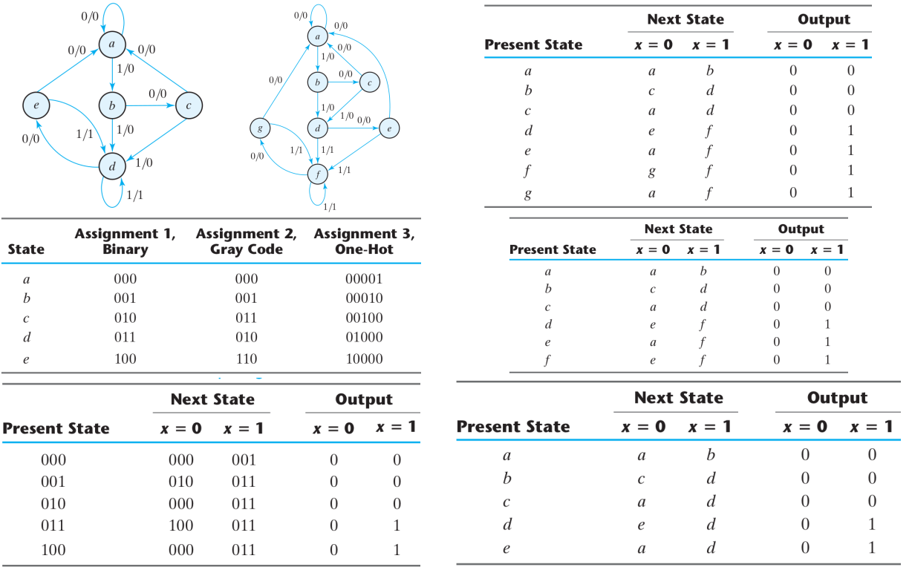
State Reduction and Assignments

Slide 22
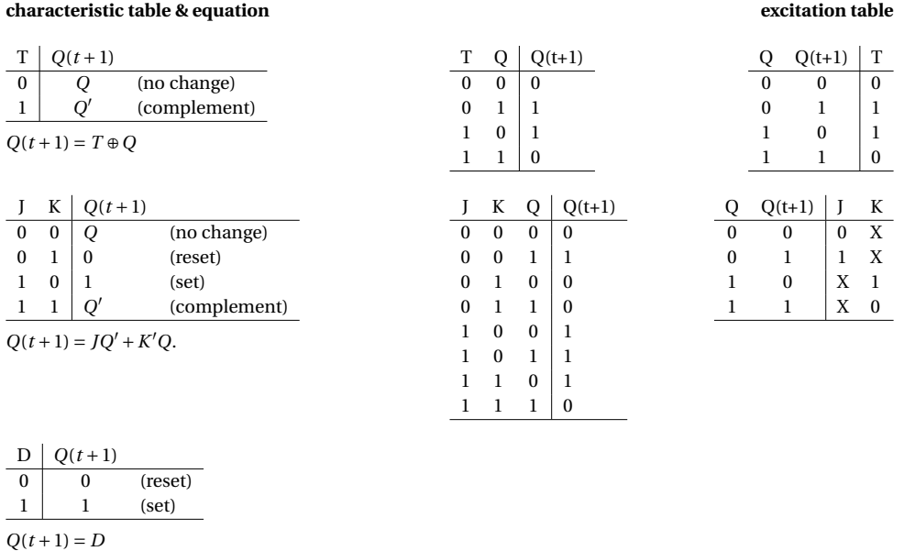
Flip-Flop Excitation Tables (inverse function)

Slide 23
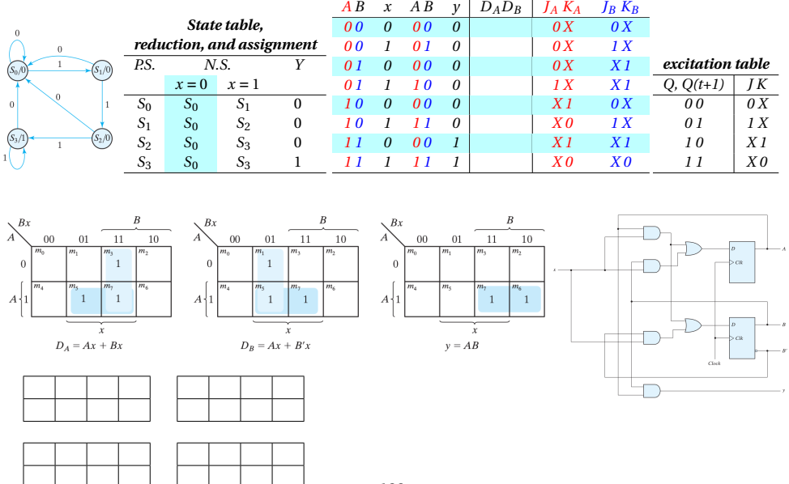
Ex: Detect 3 ones in row (overlap)

Slide 24
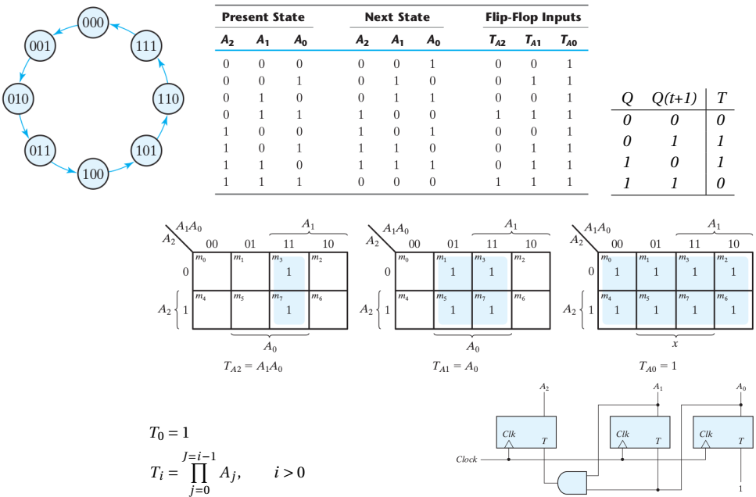
Using a T FF, design a circuit that counts from 0 to 7 compare to D and JK

Slide 25
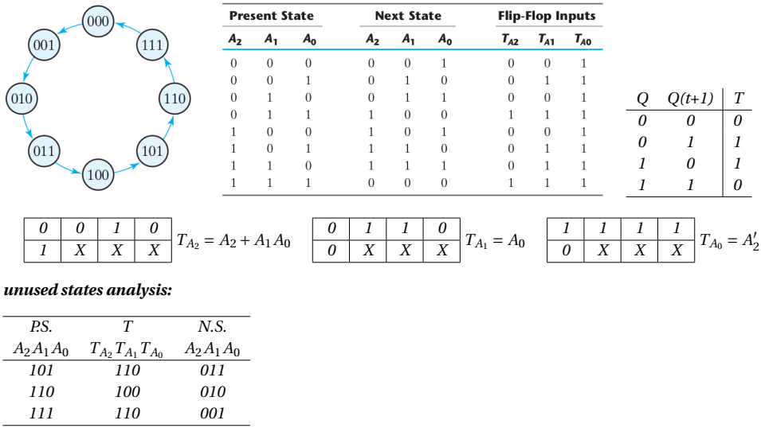
Using a T FF, design a circuit that counts from 4 to 4 and check for unused states

